Slide 1


MANDATORY Color Scheme
Note: This is the official
color scheme for DEPI
Feel free To use it
#047954
#0FAB7D
#336EA8
#D7B119

Slide 2
Renewable Energy Suitability Analysis
Presented by:
Shahd Abdelnaby
Esraa Atef
Ahmed Hamada
Mohamed Hussain
Dina Ayman

Slide 3
1. Problem Being Solved
Choosing the right locations to install solar or wind energy systems is difficult because every area has different environmental conditions.
Some places have high sunlight (DNI), others have strong wind (MS50M), while some have high humidity or temperature that reduce efficiency.
So, without proper analysis, decisions can be inaccurate and expensive.
2. Proposed Solution (Our High-Level Idea)
We analyzed 15 different locations using key environmental indicators:
DNI, Wind Speed (MS50M), KT, Humidity (R2HM), Temperature (T2M), and Wind Range.
We cleaned the data, normalized it, scored every location, and compared them in Power BI.
This allows us to clearly identify:
Best locations for solar energy
Best locations for wind energy
Best locations for a hybrid system (solar + wind)
3. Unique Value of Our Project (Why It Stands Out)
We combined solar + wind + hybrid analysis in one project (rare and more impactful).
We used a multi-criteria scoring model, making the ranking accurate and reliable.
We built an interactive Power BI dashboard that allows users to explore every location easily.
Our model helps decision-makers choose the best sites faster and reduce investment risks.
The approach is scalable — we can apply it to 100+ locations in the future.

Slide 4
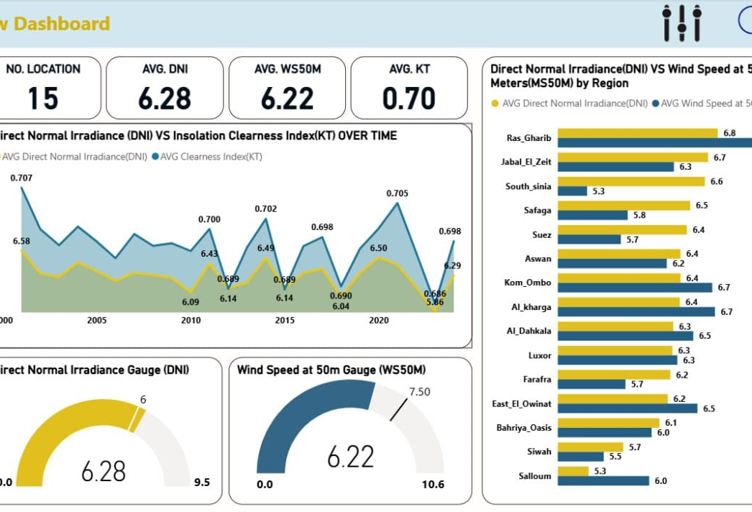
This dashboard presents an overview of renewable energy resources across 15 locations in Egypt. It analyzes average solar irradiance, wind speed, and atmospheric clearness, while also comparing regions to identify the most suitable sites for solar and wind energy projects. The results highlight that areas like Ras Ghareb and Jabal El Zeit have exceptional wind potential, while southern regions show strong solar resources, supporting strategic planning for renewable energy development.
KPIS
Filters
Bar Chart
Area Chart

Slide 5
End Users
Government Energy Planners
Renewable Energy Developers
Investors
Researchers & Data Analysts
Key Features
Interactive dashboards
Regional solar & wind comparison
Time-series analysis
KPI summary indicators (DNI, WS50M, KT)
Filtering & customization tools
Visual gauges for quick insights
How Features Address User Needs
Government Planners:
Regional comparison charts help identify the most suitable locations for renewable energy projects.
Energy Developers:
Time-series trends support forecasting, planning, and evaluating resource stability over the years.
Investors:
KPI summary cards and gauges provide clear, fast insights needed for investment decisions.
Researchers & Analysts:
Interactive filters and detailed visualizations enable in-depth exploration of solar and wind resource data.

Slide 6
Database Architecture:
Relational Database: Data is organized in tables linked by Location.
Key Tables (Entities):
Location: Information about each of the 15 regions.
Parameters: Types of measured data (e.g., solar, wind, clearness index).
ALL_DATA: Annual values for each Parameter for each Location.
Relationships:
One-to-Many: Each Location in the Location table is linked to multiple records in ALL_DATA.
All tables are connected through Location to ensure consistency and facilitate analysis.

Slide 7
Main Tools:
Excel: Data storage, processing, and basic analysis.
Power BI: Data visualization and dashboard creation.
Supporting Technologies:
No additional programming languages or frameworks used.

Slide 8
Live Application:

Slide 9
Reports and Documentation:
Project Data Report (all tables and analysis results).
Power BI Dashboard documentation.
User guide for navigating and interpreting the dashboard.
Timeline for Deliverables:
Data preparation and cleaning – [25/9/2025].
Dashboard development – [10/11/2025].
Final report and documentation – [30/11/2025].
Other Final Products:
Fully functional Power BI dashboard.
Excel data files used for analysis.

Slide 10
Core Team Members & Roles:
Dina Ayman: Oversees project progress and deadlines.
Shahd Abdelnaby: Data Analyst – prepares, cleans, and analyzes the data.
Esraa Atef: Dashboard Developer – creates and designs the Power BI dashboard.
Ahmed Hamada: Documentation Specialist – writes reports and user guides.
Mohamed Hussein: QA & Support – tests the dashboard and ensures data accuracy.
Dina Ayman: Oversees project progress and deadlines.
Collaboration Methods:
Communication via WhatsApp and Google Meet.
File sharing via Google Drive.

Slide 11
Shahd Abdelnaby: www.linkedin.com/in/shahd-abdelnaaby/
Esraa Atef: www.linkedin.com/in/esraa-atef-5a821430b/
Ahmed Hamada: www.linkedin.com/in/ahmed-hamada-farag-a48b77378/
Dina Ayman: www.linkedin.com/in/dina-ayman-darwish-a85405355/
Mohamed Hussain:

